Slide 1

The house of horese

Slide 2
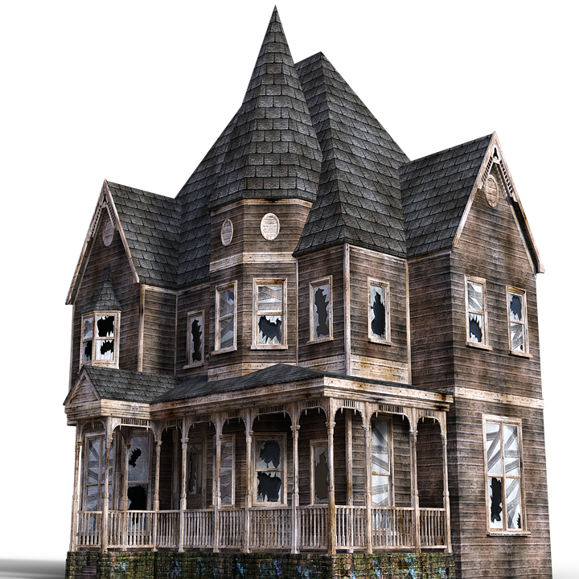

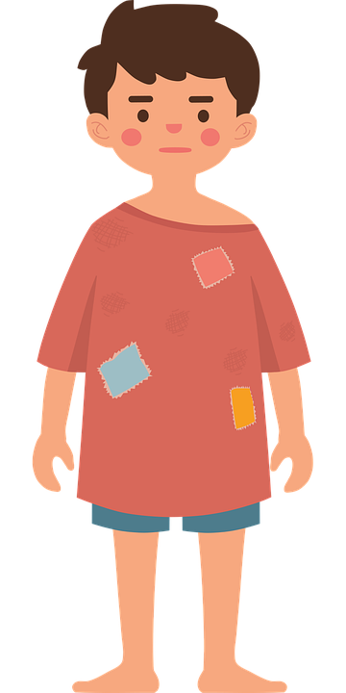
FAKE

Slide 3




creeeeeeeeaaakk
aaaaaaaaaaaa
I want to suck your blood

