Slide 1
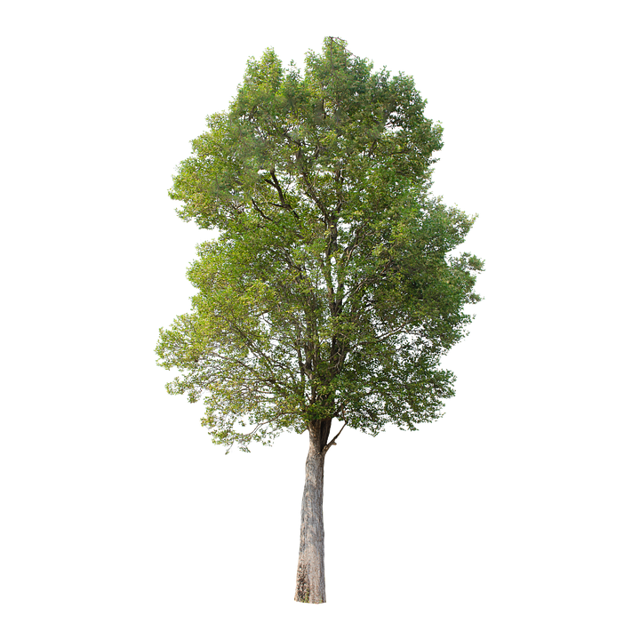
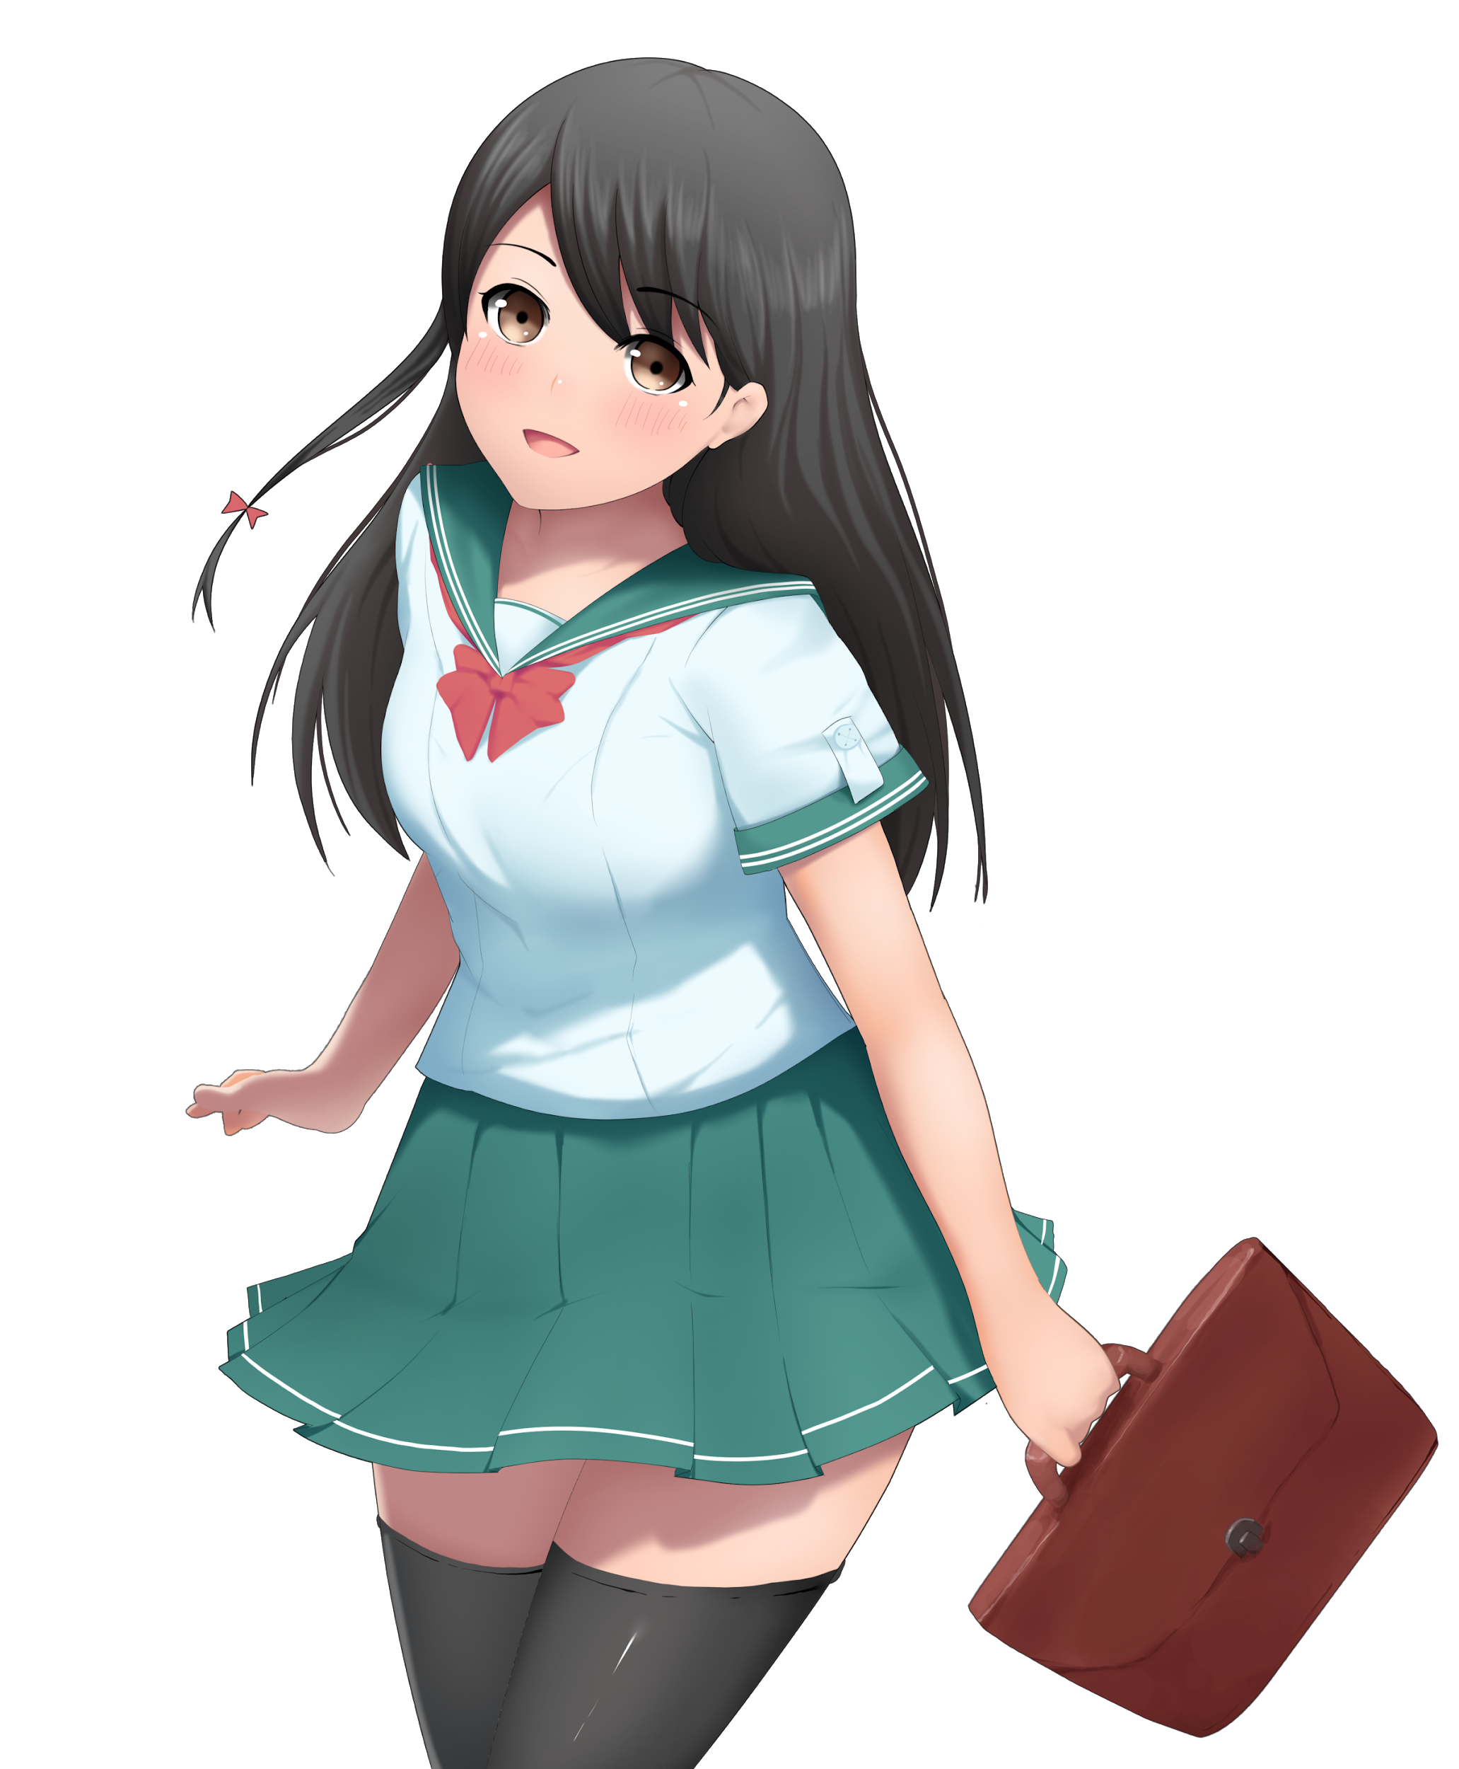
Comic strip
I wonder what’s for tea?

Slide 2
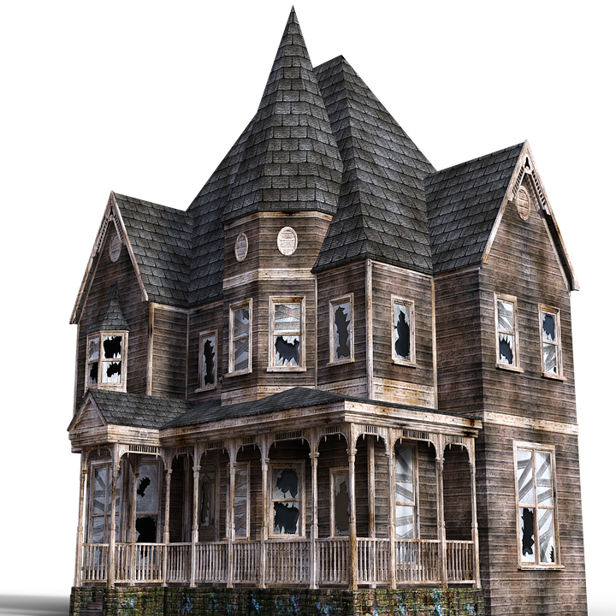
Shall I go in?

Slide 3
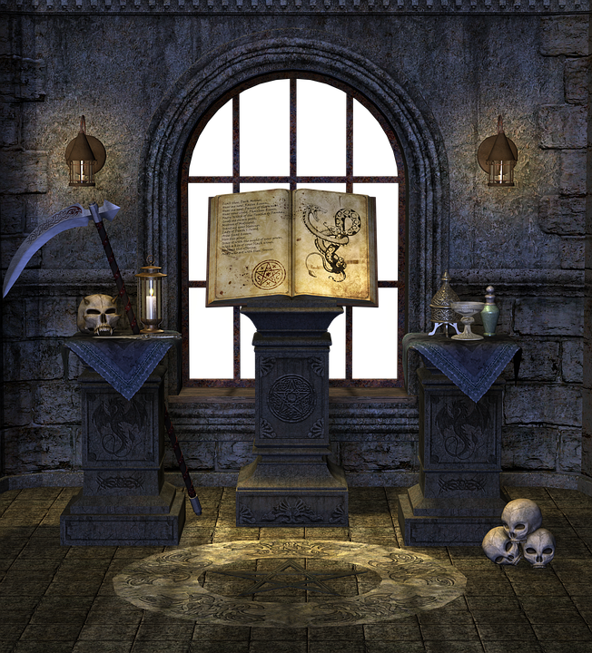

oooooooooooooooooo!
aaaahhhhhh!

Slide 4
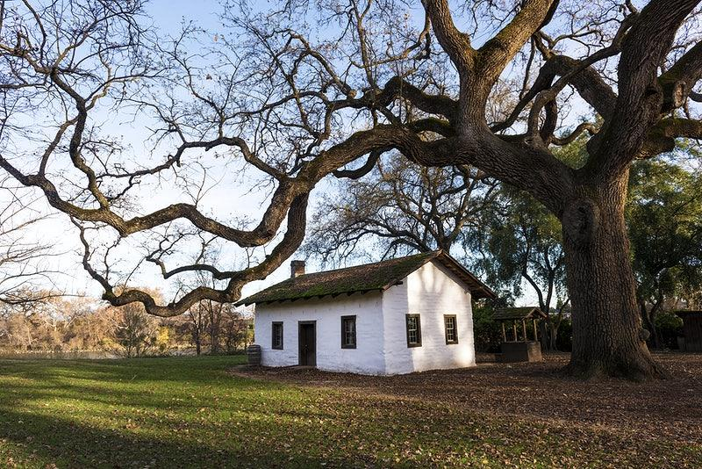
MUM I SAW A GHOST!
You were daydreaming

