Slide 1
The Girl and the VAMPIRE

Slide 2

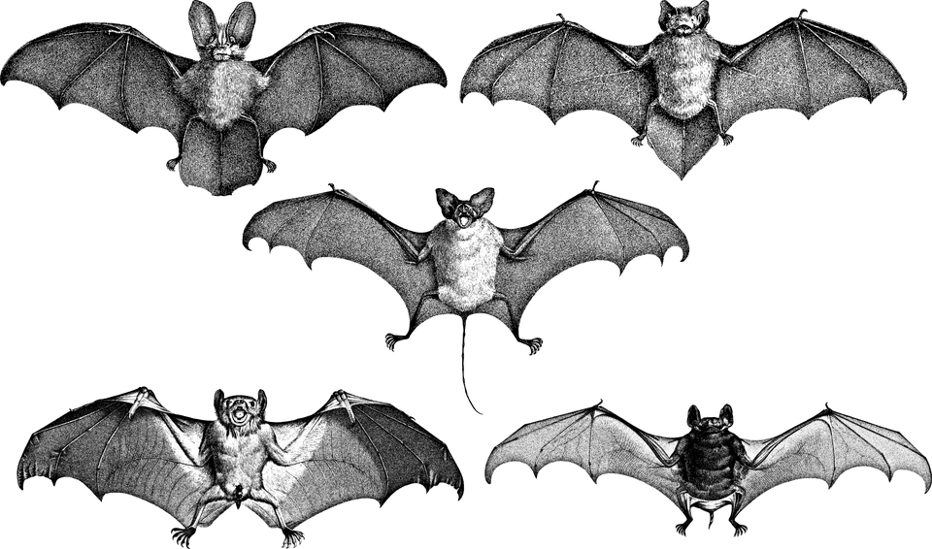
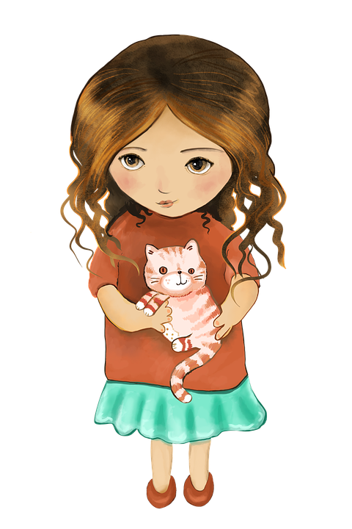
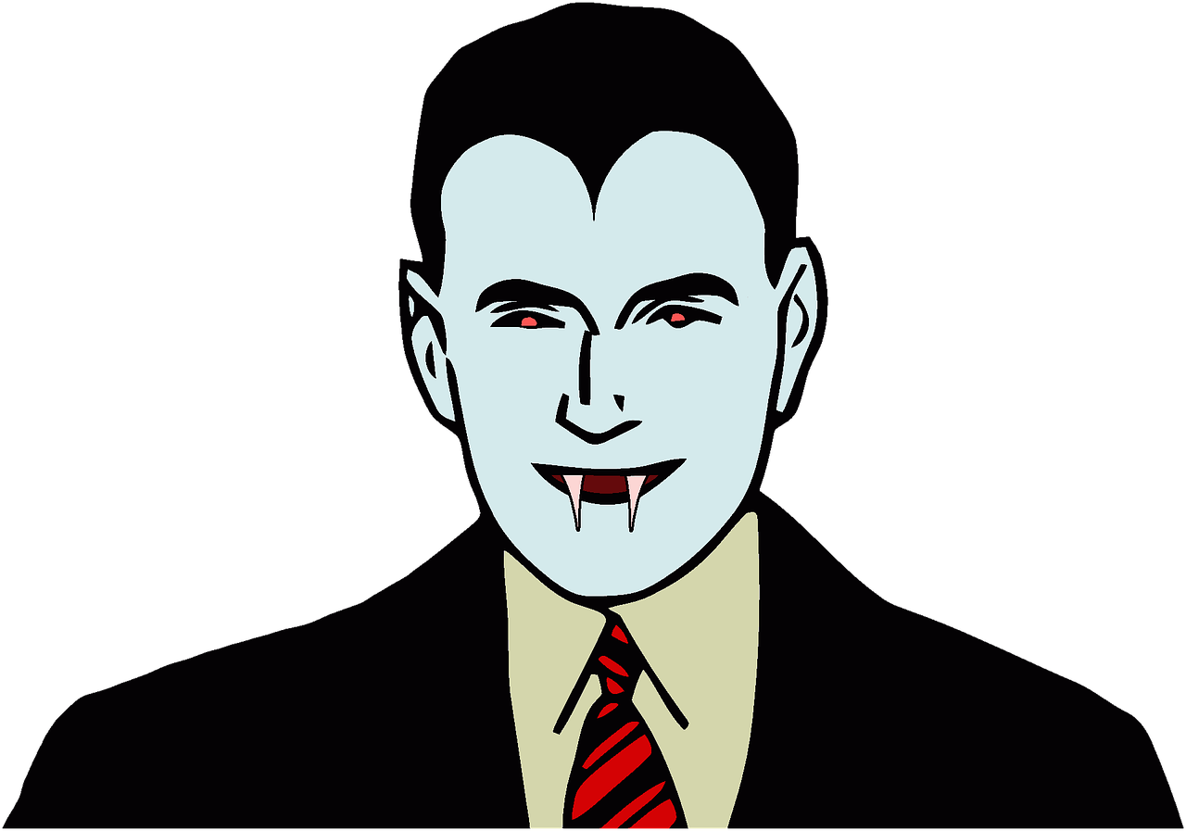
This is a cool place

Slide 3
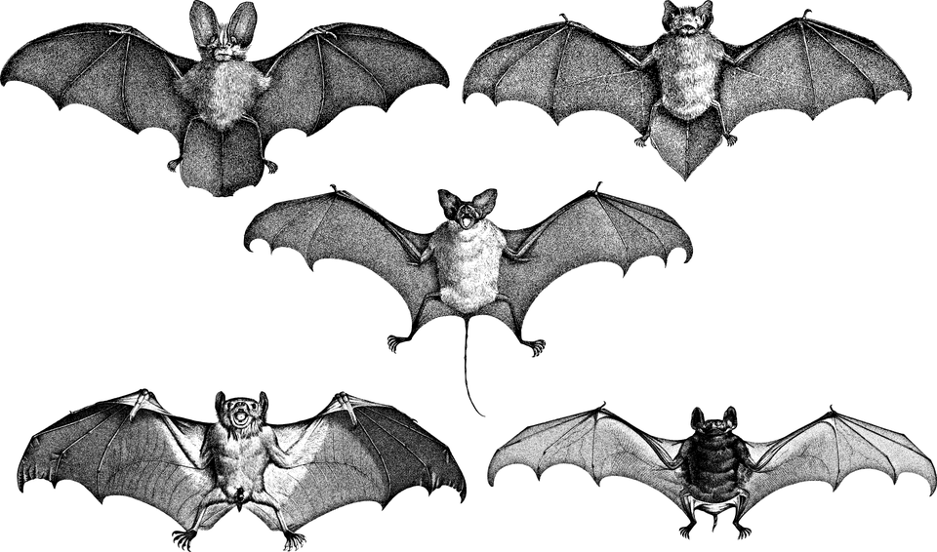
FFFFLLLAAAAPPP
AHHHHHHHHH BATS!!!!!

Slide 4

HI
WHY HELLO THERE

Slide 5
HEHEHEHE
Why ya leaving so early

Slide 6
The end

