Slide 1
THE TERRIBLE TERRIBLE WALK
By Ivor Scott and Henry Hiscock

Slide 2
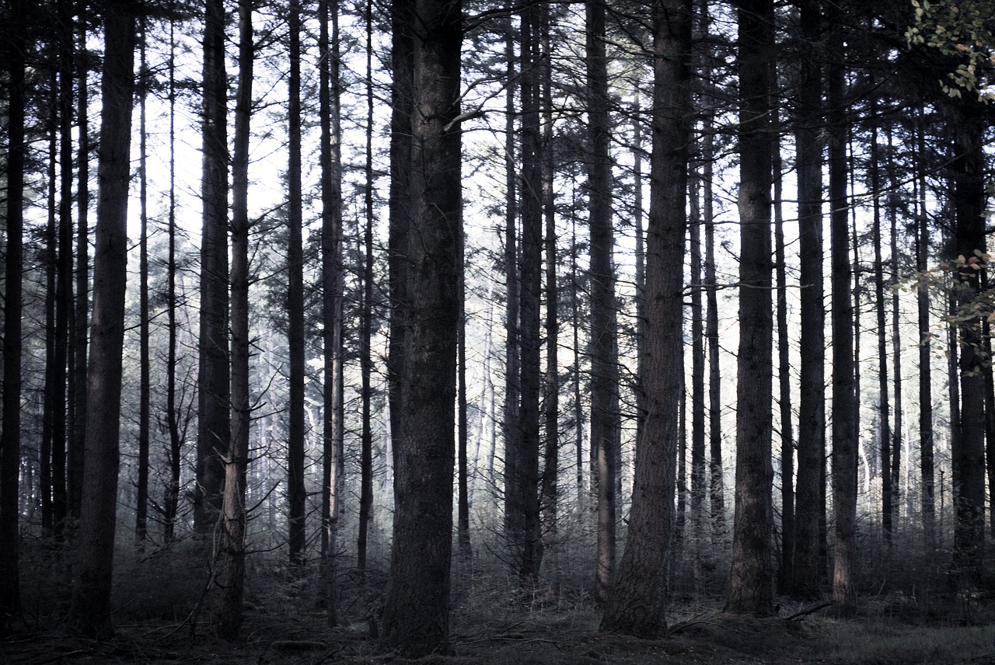
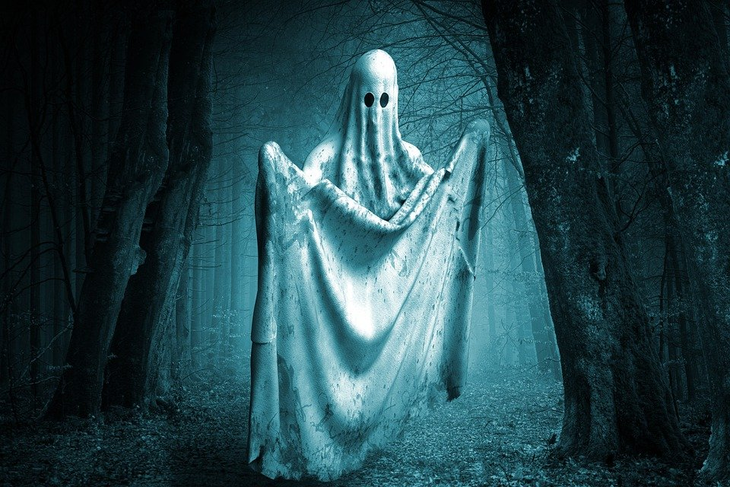
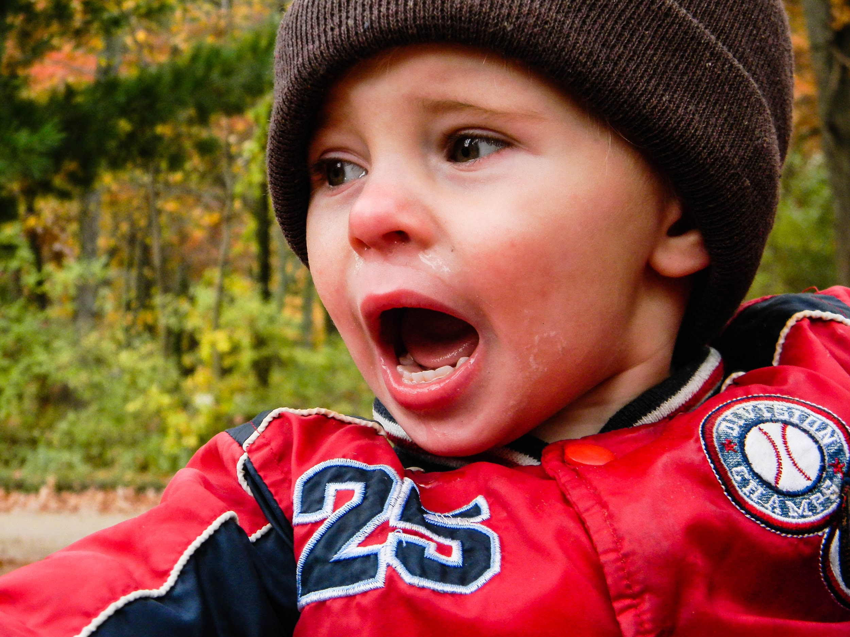
Who is lunch?
ARRRRHHHHH

Slide 3
Yum Yum a Child
Don’t hurt me

Slide 4
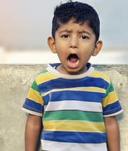
NEVER
GET AWAY FROM MY BRO

